Slide 1

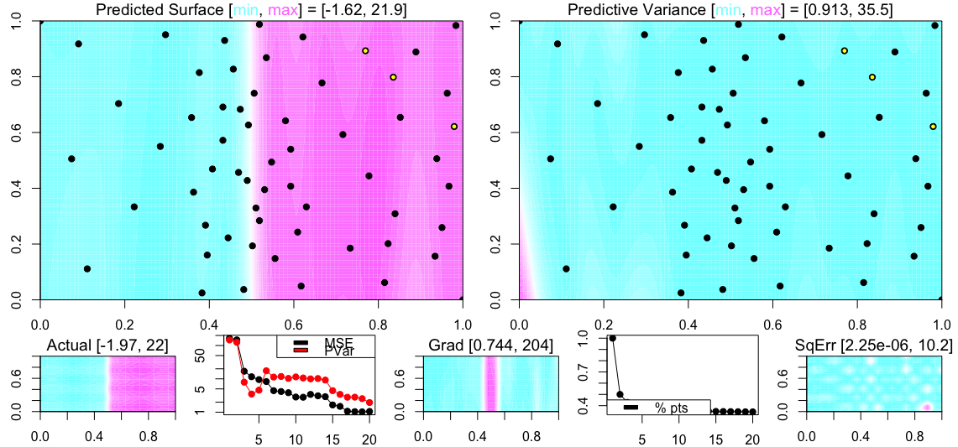
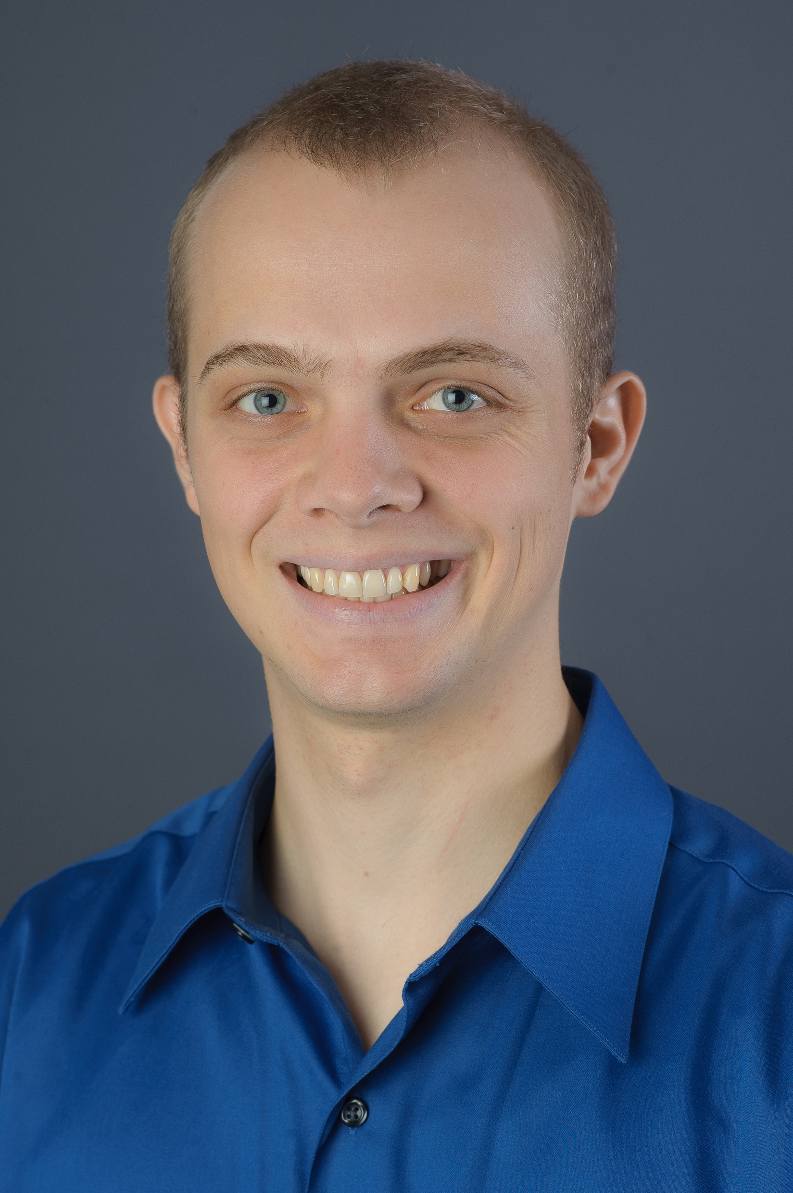
Project Title
Title Font Size: 20
The ONR (Top Left) and NPS (Top Right) logos must remain present.
Header Font: 14 (Bold)
General Text: 14 (12 if Lack of Space Requires)
Font Style: Calibri
SEAP/NREIP Student:
Collin Erickson
Northwestern University
PhD candidate
ce@u.northwestern.edu
Mentor:
Susan Sanchez
SEED Center for Data Farming
ssanchez@nps.edu
Student Photo
Image of Research Project
Project Dates: 6/20/16– 8/26/16
Project Objective and Research Approach:
Our aim was to provide an adaptive sampling algorithm that will identity interesting features in the response surface while also maintaining favorable design properties, such as space-filling. Our algorithm uses candidates from a sFFLHD design and identifies interesting areas using the norm of the gradient of the fitted kriging surface. Minimum energy is used to ensure that points selected are sufficiently spaced throughout the space.
Results / Accomplishments / Next Steps:
I implemented the algorithm in R, and also made it available as a Shiny app. We have run it on test problems. It seems to give better results than other methods, but requires more testing. The next step is to use it with military simulations provided by the SEED Center to see if it provides the desired results. If that works then we will make it available for long-term simulations so that it can be run in the background until results are needed.
Important Notice:
Final Quad Chart Submission must be in PowerPoint (.pptx) format!
Distribution Type A Type

